Slide 1

DriverPass
System Analysis
Cayden Clark
Notes:
[No speaker notes required for this slide.]

Slide 2

System Requirements
Functional Requirements:
  Students can book, reschedule, or cancel driving lessons online.
  Instructors can view their daily schedule and log completed lesson notes.
Nonfunctional Requirements:
  Security: Passenger and payment data must be fully encrypted.
  Performance: The scheduling page must load in under 2 seconds during peak hours.
Notes:
To make sure this software helps the driving school run smoothly, the focus was: what the platform does for you, and how well it runs. On the operational side, your students will be able to log in at any time to book, change, or cancel a driving lesson without needing to call the office. The driving instructors can also log in from their phones to check their daily routes and leave quick notes on how a student performed. Behind the scenes, we are making sure the site is fast, so clients don’t get frustrated and walk away, and we are putting safety locks on the system, so all personal information and payments stay safe and private.

Slide 3
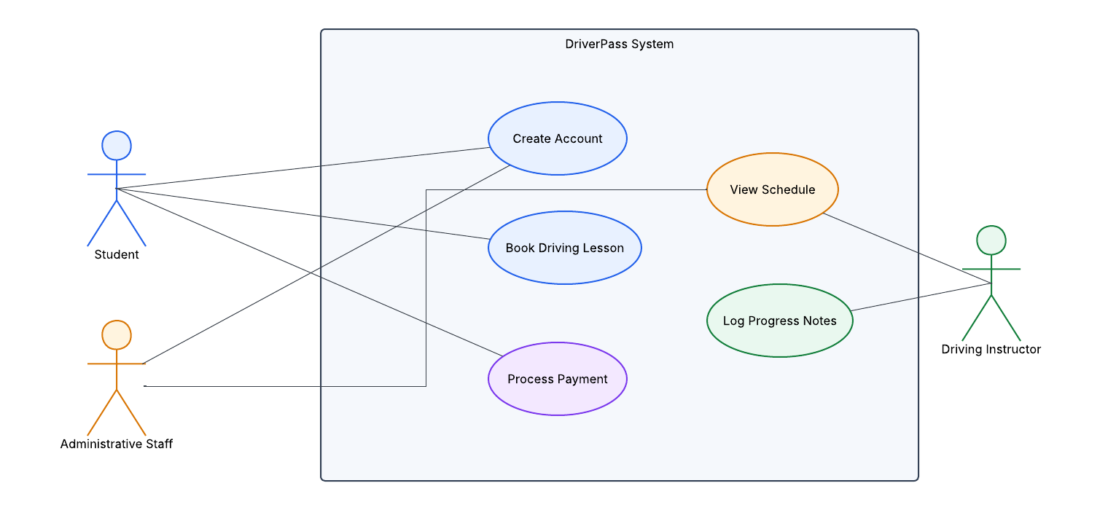
Use Case Diagram
[Insert your use case diagram here.]
Notes:
This slide maps out who will be using your new platform every day and what they can do on it. We have divided the system's users into three main groups: the students, the driving instructors, and the front-office staff. For your students, the process is simple. They can hop online, set up a profile, look over the driving package deals, and pick an open slot for their behind-the-wheel training. The instructors can look at their smartphones to see who they are training that day and leave feedback notes right after the lesson. Finally, the office staff have a view of everything, allowing them to handle scheduling changes and process incoming payments all in one spot.

Slide 4
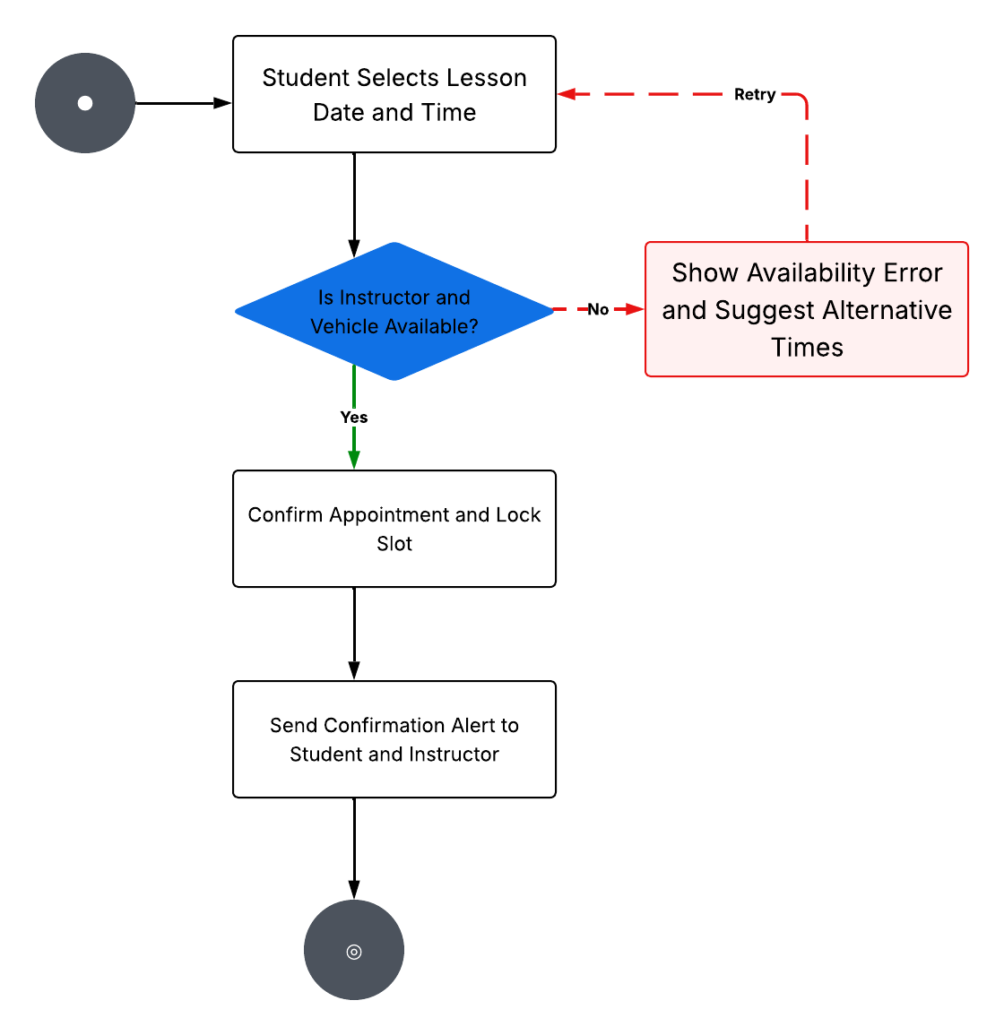
Activity
Diagram
Notes:
This slide shows the step-by-step path a user takes when completing a task. Let's look at booking a driving lesson as an example. When a student wants to schedule an appointment, they pick their preferred day and time. The platform scans the instructors' calendars. If an instructor is free, the system claims that slot, alerts both the student and the teacher, and locks it in. If that instructor is already booked, the platform prevents a double-booking error from happening and asks the student to choose a different time. This makes sure the schedule stays organized without any scheduling mix-ups.

Slide 5
Security
Data Protection: Keeps personal student profiles and contact details safely hidden.
Secure Logins: Password protection for staff, instructors, and customers.
Payment Safety: Safe handling of credit cards and transactions through secure digital locks.
Role-Based Access: Instructors and students only see their own information to keep files private.
Notes:
Keeping the business and the customers safe is the top priority, so we built strong safety measures into every layer of this system. All personal student data, like phone numbers and home addresses, is properly secured. Everyone gets their own secure login account. This means students can only see their own lessons, instructors can only see their assigned students, and the financial data stays private to the admin team. We also make sure that when people pay for driving packages online, their card information goes through secure digital locks. This protects your business from fraud and gives your clients peace of mind.

Slide 6
System Limitations
Internet Access Required: Users need an active internet connection to view or update schedules.
No Live Traffic Updates: Instructors can view route maps, but the system does not show live traffic delays.
Manual Vehicle Tracking: The system tracks calendars, but it does not monitor car maintenance or fuel levels.
Notes:
Because this is a live web platform, the staff, instructors, and students need an active internet connection to see or change the calendar. Also, while instructors can view their driving routes on their phones, the platform does not feature live, automated traffic updates. It also does not track physical car maintenance, like when a vehicle needs an oil change or gas. Knowing these boundaries helps plan ahead for future updates as the driving school grows.

